Slide 1
NAU MAI, HAERE MAI
WELCOME

Slide 2
NGĀ KAI O ROTO (CONTENT)
Karakia (prayer)
Māori alphabet & pronunciation principles
Greetings & farewells
How to structure a pepeha
Tikanga basics explained

Slide 3
KARAKIA
E te atua
Hōmai tō kaha
Hōmai tō aroha
Hōmai tō māramatanga
Hei āwhina i a mātou
Ki te ako, kia mau
Haumi ē hui ē, tāiki ē
God
Give me your strength
Give me your love
Give me your understanding
To help us
Learn and retain
Let it be so

Slide 4
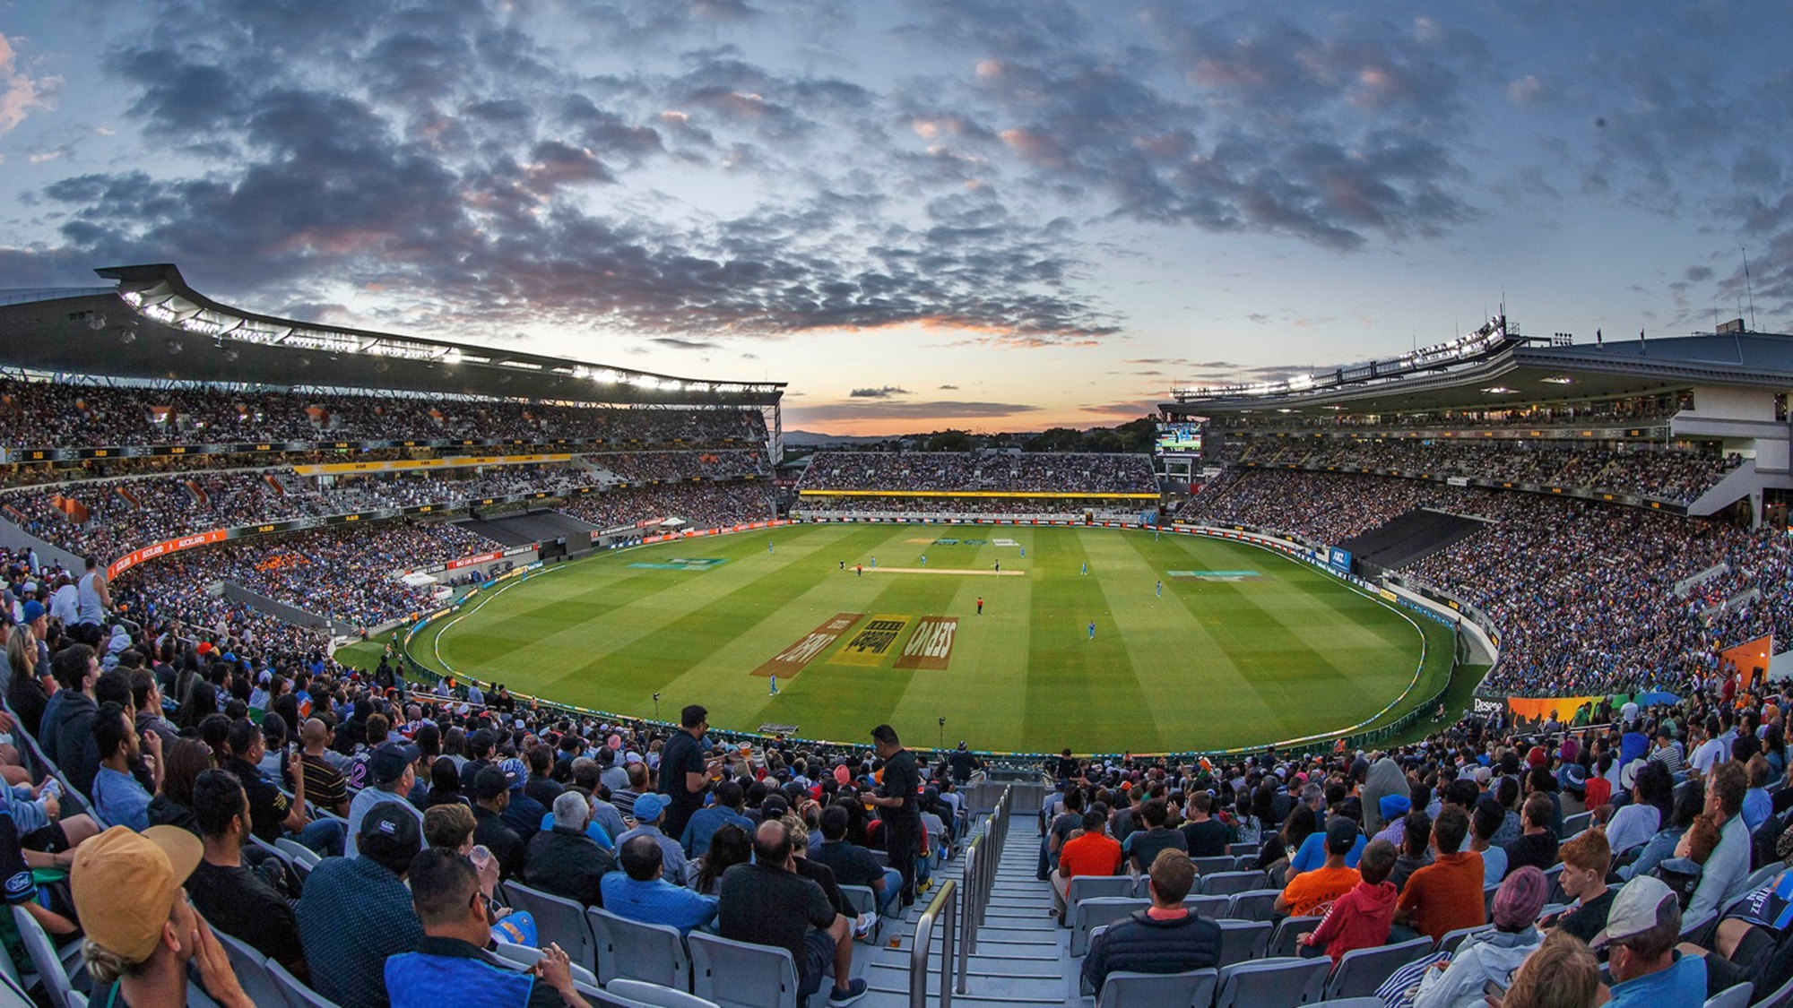
TE ARAPŪ MĀORI (MĀORI ALPHABET)
OROPUARE – VOWELS
A E I O U
OROPUARE ROA – LONG VOWELS
Ā Ē Ī Ō Ū
OROKATI – CONSONANTS
h, k, m, n, ng, p, r, t, w, wh

Slide 5
TE ARAPŪ MĀORI
AA EA IA OA UA
AE EE IE OE UE
AI EI II OI UI
AO EO IO OO UO
AU EU IU OU UU

Slide 6
GREETINGS AND FAREWELLS
Greetings to one Tēnā koe (formal) Kia Ora (informal)
Greetings to two Tēnā kōrua (formal) Kia ora kōrua (informal)
Greetings to three or more Tēnā koutou (formal) Kia ora koutou (informal)
Greetings to a friend Tēnā koe e hoa (formal) Kia ora e hoa (informal)
See you tomorrow Hei āpōpō
See you (again) Ka kite (ano)
With best wishes Ngā manaakitanga
Regards Ngā mihi

Slide 7
PEPEHA AND TIKANGA
What is a pepeha? https://www.youtube.com/watch?v=0ASXP21P_7U
What is tikanga? https://www.youtube.com/watch?v=_q-iWm9kD3A

Slide 8
KARAKIA WHAKAMUTUNGA
Tūtawa mai i runga
Tūtawa mai i raro
Tūtawa mai i roto
Tūtawa mai i waho
Kia tau ai te mauri tū
Te mauri ora ki te katoa
Haumi e, hui e, tāiki e!
I summon from above
I summon from below
I summon from within
I summon from the surrounding
environment
The universal vitality and energy
to infuse and enrich all present
We are unified and ready to act!

